Slide 1
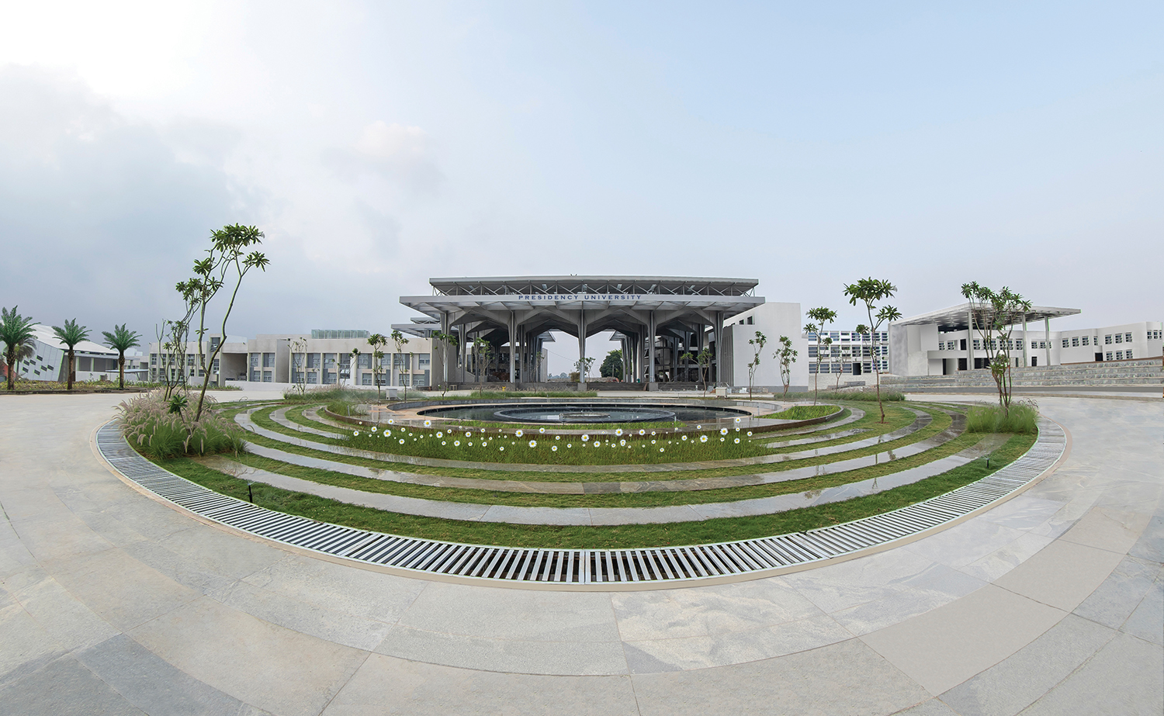

Serialize and Deserialize an object
Presented by,
PRACHI AMOL GADHIKAR
Assistant Professor
School of Engineering

Slide 2
Serialization and Deserialize
Object serialization is the process of saving an object's state to a sequence of bytes, as well as the process of rebuilding those bytes into a live object at some future time.
The Java Serialization API provides a standard mechanism for developers to handle object serialization.
The API is small and easy to use, provided the classes and methods are understood. This hands-on lab takes you through the basics of using Java serialization.

Slide 3
Serialization and Deserialize
In this exercise, you will learn how to do serialization and deserialization of the an object. You will also learn how to use transient keyword.
Serialize the current time
Use transient keyword

Slide 4
Java FileOutputStream Class
Java FileOutputStream is an output stream used for writing data to a file.
If you have to write primitive values into a file, use FileOutputStream class. You can write byte-oriented as well as character-oriented data through FileOutputStream class

Slide 5
Java FileInputStream Class
Java FileInputStream class obtains input bytes from a file.
It is used for reading byte-oriented data (streams of raw bytes) such as image data, audio, video etc.
You can also read character-stream data

Slide 6
Java ObjectOutputStream class
The Java.io.ObjectOutputStream class writes primitive data types and graphs of Java objects to an OutputStream.
The objects can be read (reconstituted) using an ObjectInputStream.

Slide 7
Java ObjectInputStream class
The objectinputstream class is mainly used to deserialize the primitive data and objects which are written by using ObjectOutputStream.

Slide 8
printStackTrace()
The printStackTrace() method in Java is a tool used to handle exceptions
and errors.
It is a method of Java’s throwable class which prints the throwable along
with other details
like the line number and class name where the exception occurred.

Slide 9
getInstance()
The getInstance() method of java.util.Calendar class is a Static method.
This method is used with calendar object to get the instance of calendar
according to current time zone set by java Runtime environment.

Slide 10
getTime()
The getTime() method of Java Date class returns the number of milliseconds
since January 1, 1970, 00:00:00 GTM which is represented by Date object.

Slide 11


